Slide 1



Chapter 8: HTML Images
Moe Harb
moe@cumberland.college
Basic <HTML> Programming
CUMBERLAND COLLEGE

Slide 2
The role of Visuals in Webdesign
01

Slide 3
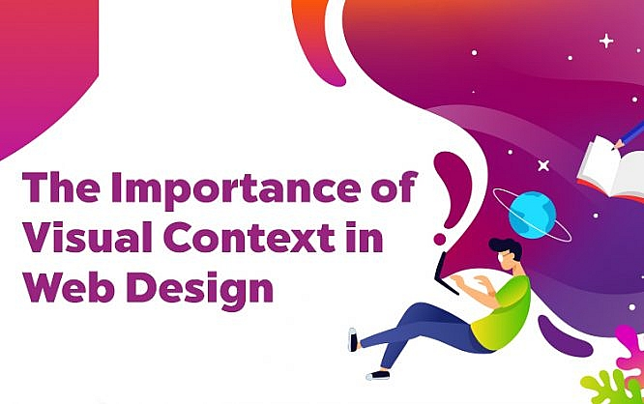

Slide 4
Introduction
In the early days of the internet, it was all about the text. There were not so many options and technology wasn’t as advanced to support crazy designs.
But as the world wide web progressed, so did the web design options. The focus slowly shifted towards the visual side. Besides informing the users, the designers aim to entertain, engage, and wow them with creative ideas.
People are visual beings, which means that visuals help them to have a better understanding of the message that your website wants to convey. If you want to make an impact on the users, improve user experience, and keep them longer on the website, adding visuals is the way to go.
While visuals are a necessary element for rounding up your web design, what about visual context?

Slide 5
What is Visual Context?
Visual context helps the design to convey the message.
Website owners want to deliver specific information through their website design. For example, an interior design company aims to show their expertise in their field. This is when visual context steps in. By using images that show their previous design projects within the web design, they can show the website visitors their vision.
Just think about it. If you need an interior designer would you rather give a chance to one that has images of beautiful designs or to one that just has plain text?
Visual context simply supports the claims on the website and helps the website visitor to instantly know what the website is about.

Slide 6
Why Should You Use Visual Context?
Visually pleasing websites always perform better. They grab and retain uses attention, unlike blocks of text which are more likely to drive them away.
Some types of visual context that you can use:
- Images (explaining the web site’s purpose, presenting the business, supporting topics)
- Infographics (presenting the most important information)
- Lines, arrows, patterns, highlighted numbers (showing and simplifying directions)
- Icons (navigating the users through the website)
It doesn’t matter whether the website is for a blogger or an e-commerce business owner, visuals should be welcome to the website.
When it comes to power which visual context has, here are some of the benefits you’ll get if you use visual context in your web design.

Slide 7
1. Improve the First Impression
The first impression matters. That is a fact. Especially in the competitive internet world, where so many websites are battling for the users’ attraction.
It only takes 50 milliseconds for people to form a first impression. So, if a user comes across the website and finds the design dull, it is very likely that he or she will exit the page without much thought. Eliminate that risk by adding visuals.
Visuals will make the website more attractive and get the users to check out the website. There is just something about images and visuals that keeps our attention and makes us want to know more.

Slide 8
2. Give Users Better Explanations
Whenever a website features some sort of instructions or tutorials or even just a simple explanation, visual context can be a great addition to it.
People follow visual instructions 323% better than written instructions. Therefore, the visual context will enhance user experience and enable users to understand the instructions more easily.
Offer them information in a manner that will make it more understandable. The users will be more daring to explore the website when they can grasp the information without much trouble.

Slide 9
3. Make the Website Memorable
According to some studies, people will remember 65% of the visual content that they saw, even if they are asked about it almost three days after. On the other hand, they can recall only about 10% of the written content that they read, three days later.
“Whether you use images or videos, adding visuals will help the users to remember your website. The visuals act like a stamp which makes a lasting impression in people’s minds,” says Miriam Pierson, a web designer at Subjecto.
For example, you can use visuals to tell a story. Through storytelling, you’ll be able to make the website’s content more convincing and effective.

Slide 10
4. Get Inspired by the Visuals
Visual context needs to be seamlessly integrated with the text.
While your content strategy probably starts with the idea to write the text and then add visuals, you can also take a different approach. If you find an inspiring image you can easily write the text that will complement it.
Another option is to find or create a video that rounds up your web design idea and then write the content that will support it.

Slide 11
5. Make It More Interesting
Sometimes you have no other choice but to deliver lots of written text, information, and stats. However, you do have a choice to add visual context to it and thus make it more interesting for users.
For example, when you are delivering stats about the company, you can create an infographic to present the information. Consider that 41.5% of marketers claim that original graphics, such as infographics, perform best, this is a perfect way of presenting content.
Not only can visuals make the content more interesting but it can also evoke emotions in users. Consequently, you’ll be able to create a relationship with them and turn them into loyal users or customers.

Slide 12
Why good images have substantial impact on your website (potentials):
• Increase the average number of pages visited
• Increase traffic to your website
• Increase the number of social shares
• Increase time on site
• Increase total sales for a product
• Improves SEO on your site
Visual context can bring your website to life. Without them, the website wouldn’t be as appealing, effective, and important as they are now. Use visual context to highlight the important message, to make it more fun for users, and to build trust in them. You’ll be surprised how powerful and impactful visuals can be. Choose the visual context carefully because otherwise, it can just confuse the users.

Slide 13
Different Types of Images on Webpages
02

Slide 14
Different Types of Images in Web Pages
Only a few types of web graphics are used in emails. Not every type of web graphic file can be used when building web pages and doing web design. There are three types of graphics that are used the majority of the time.
The proper use of web graphics makes the difference between a web page that has a professional appearance and a web page that doesn’t. We take great pains to make sure the websites we build don’t just look great, but follow technical best practices. This means making images small in file size for faster page loading times.
Here at Massive Impressions, our clients and partners ask all the time what type of graphics should be used in specific cases. We’ve created this guide for you that describes the different types of files usable in web graphics.

Slide 15
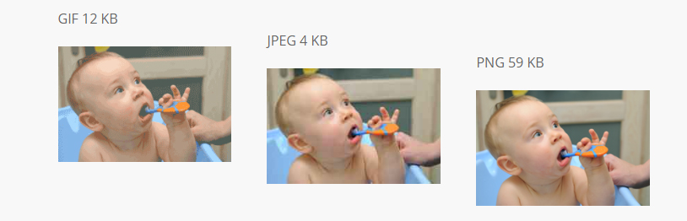
Different Types of Images in Web Pages
The images below show that PNG preserves the original image the best, but it has a larger file size. The JPEG file size is much smaller than the file size for PNG or for GIF. If you are looking for a small picture size, JPEG is the best option here.

Slide 16
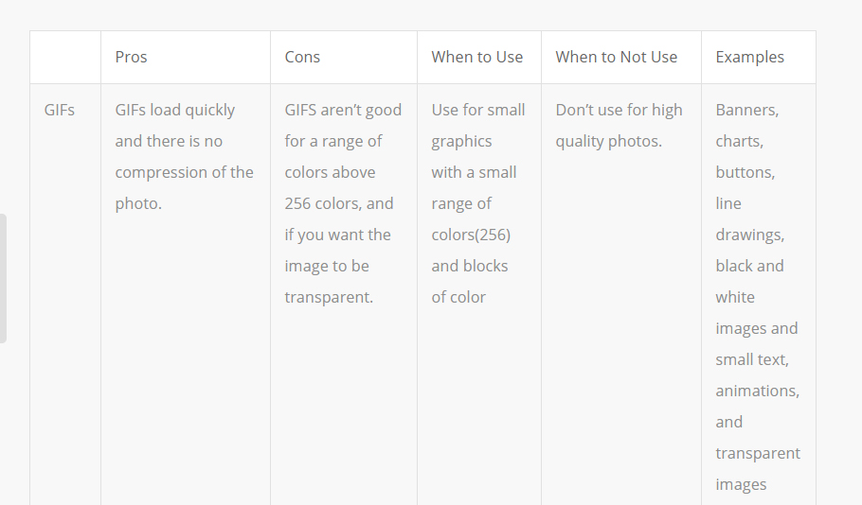

Slide 17
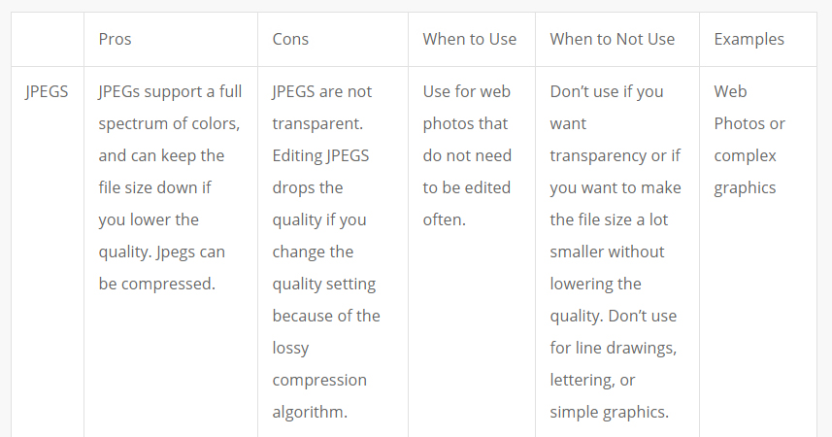

Slide 18
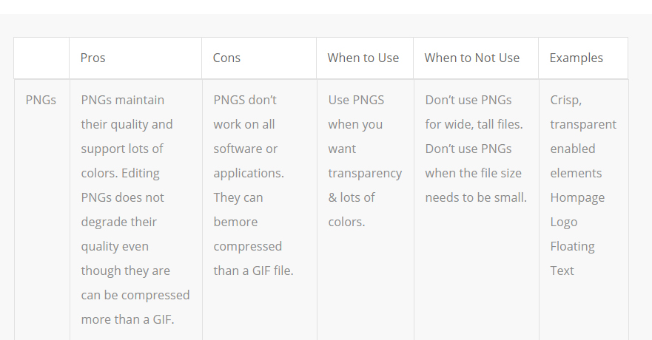

Slide 19
Different Types of Images in Web Pages
If image was a certain name & file type (jpeg, gif, png) in your html template and you want to simply replace it without affecting the code, simply replace with an image with the same file name and type.
If you want to add a new image to the website, you can chose any type you feel suitable.
Gif for animated, jpeg for compressed, and png for transparent background.
Let us open PHOTOSHOP now and learn how to create images and saving them for web as:
.jpeg
.png,
.gif

Slide 20
Creating / recreating
Images in Photoshop

Slide 21
Now open your website folder
And remember where your image was saved

Slide 22
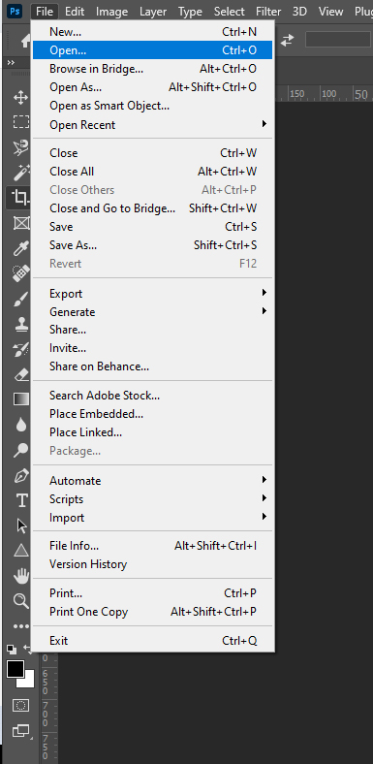
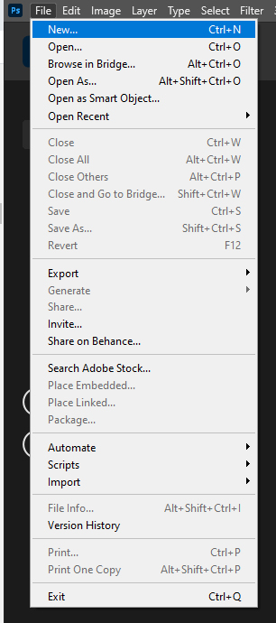
Opens existing image
This is what you will be using 99.9% of the time.
Creates new image
Only use if you are combining multiple images or recreating a graphic
You don’t need if you are replacing template images or adding images

Slide 23
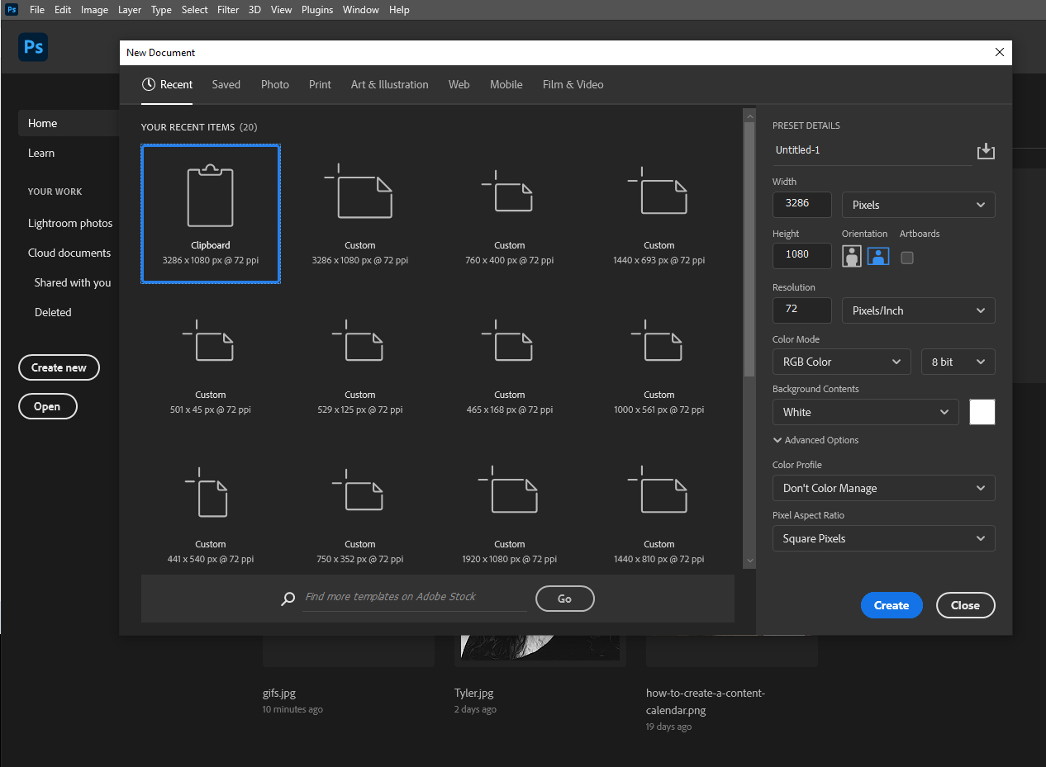
Only for file > new
Sets width
Chose pixels
For web
Sets height
Keep at 72
Keep White
Unless designing a transparent background
Then chose Transparent

Slide 24
Now open your website folder
And remember where your image was saved

Slide 25
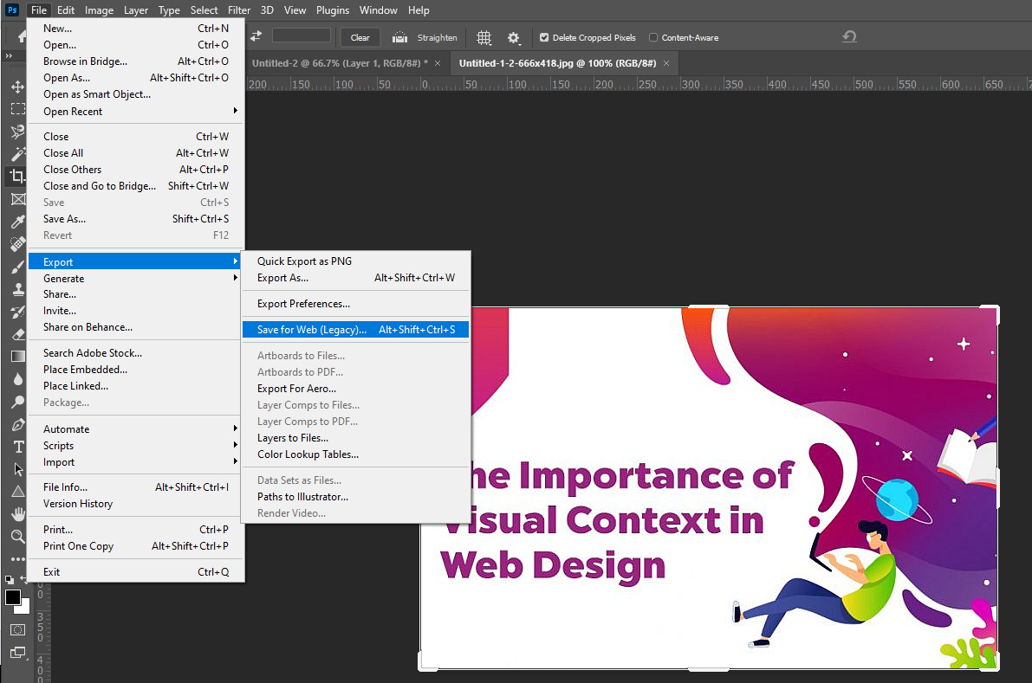
Once done photoshopping… time to optimize and save for web
File>
Export>
Save for Web

Slide 26
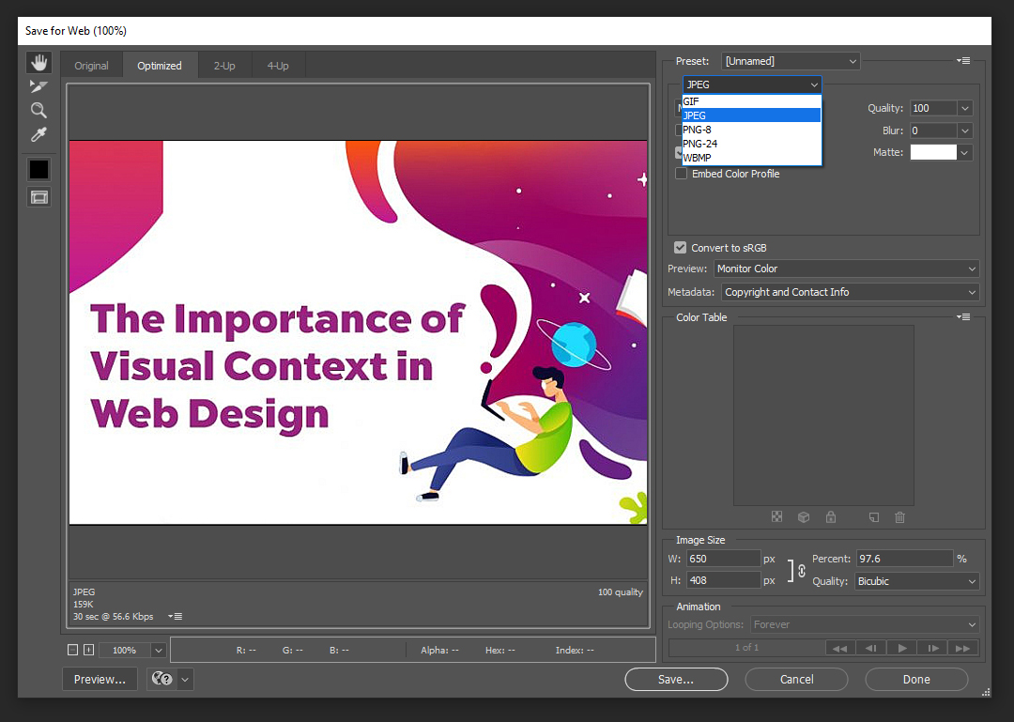
To replace, keep same as original
Chose JPEG
or PNG-24
Or GIF
Keep at 100
To replace,
keep same as original
Here is where you set width or height depending on your needs, once you set a value, click outside to set.
Now save in appropriate website folder

Slide 27
Group Exercise
Follow teacher’s in class tutorial…
In Photoshop: (file > open) method replace images from your website template with your own images
Hint:
Open the template image first, open new image, copy new image paste on top of old image delete old image layer resize new image to fit in old image canvass file > export > save for web chose same file type keep same size save with same file name in the same folder original image was at to replace it

Slide 28
Adding Images to Webpages
03

Slide 29
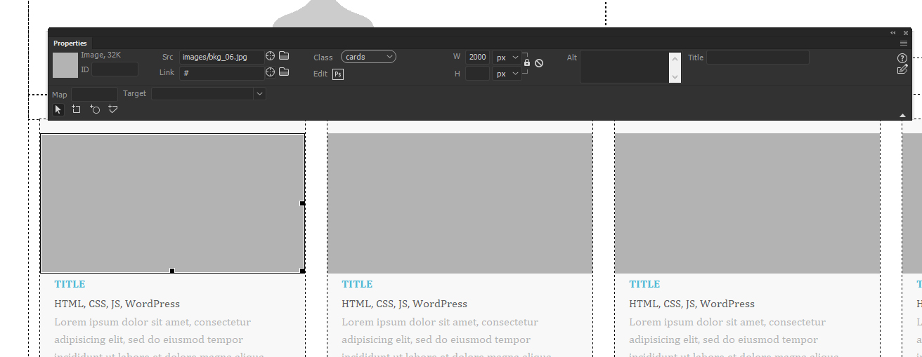
In Dreamweaver open your html file, now you should see template images replaced by your own image that you created in photoshop because you saved it under the same name and file format..
To replace image of your template with a new image that has a different name (Adding an image) , as when you replace an image in photoshop by naming it the same name as older image in template it should already be replaced..
After creating the images in Photoshop…
Highlight the image you want to replace by clicking once on it,

Slide 30
In Dreamweaver click on “folder” icon on the right beside image “Src” in properties window located after the image name

Slide 31
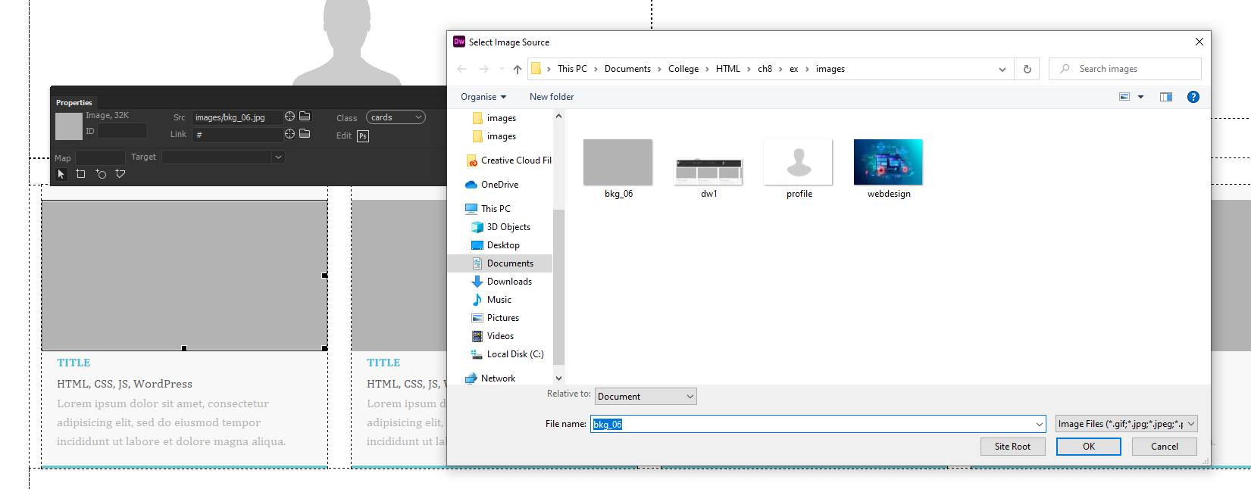
In Dreamweaver now chose by clicking on image you saved in that folder where it used to hold original template image
Then Press OK

Slide 32
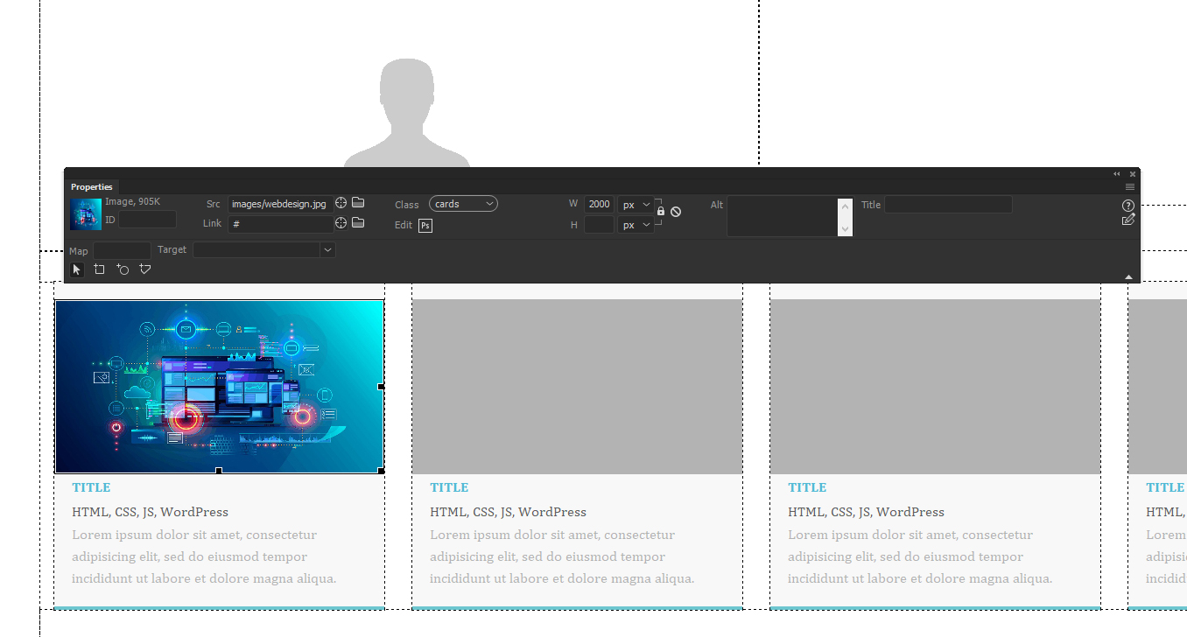
In Dreamweaver
This should add image and replace your older one that has the same size

Slide 33
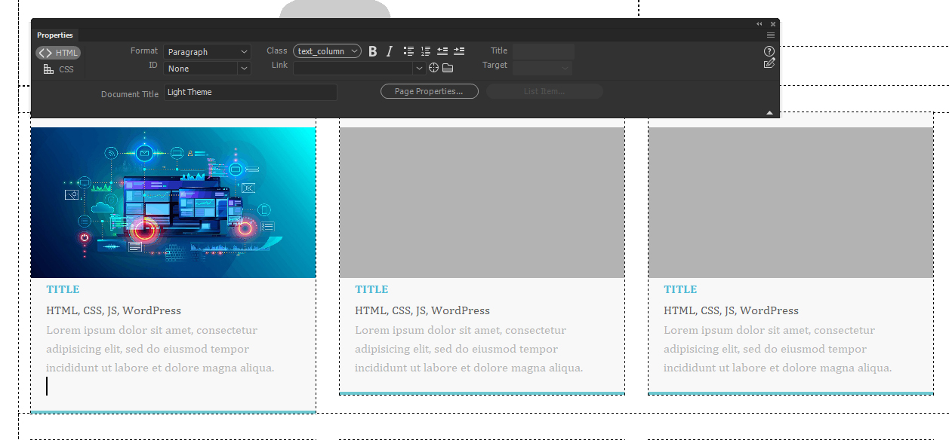
To Add image without replacing an existing image, just to a text highlight where you want to add image after pressing Enter, or return so you place it on a new line;

Slide 34
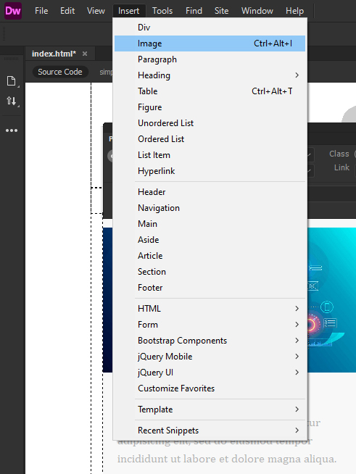
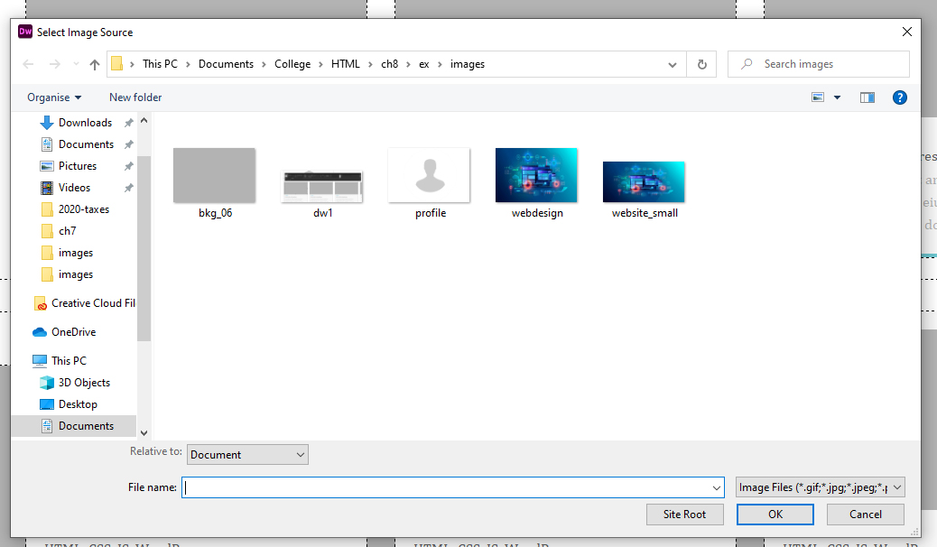
To Add image without replacing an existing image, just to a text…
Click Insert > Image in menu tab Then Chose image (already saved in website folder)
Then press OK

Slide 35
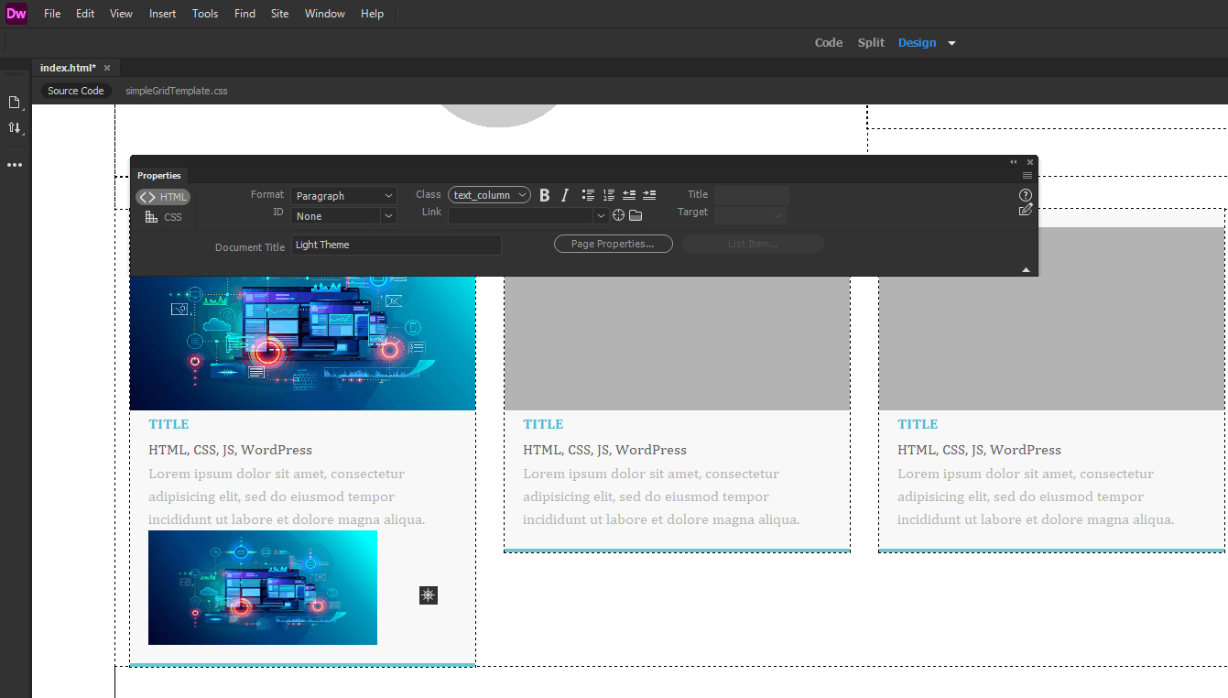
To Add image without replacing an existing image, just to a text…
Note that this method requires that you save image in a size that will fit in that column you are adding the image in or else it will be bigger and will break your website, so here you will have o try couple of times until you get it right as most html templates these days have a CSS code that shrinks an image from big to small.

Slide 36
To Add Alt tag to an image in Dreamweaver
Simply add your English text describing your image for SEO purposes in Properties Alt section after highlighting your image first
Image description

Slide 37
Image HTML Tags
04

Slide 38
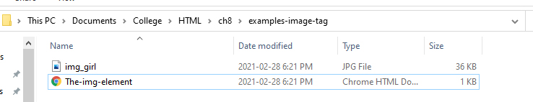
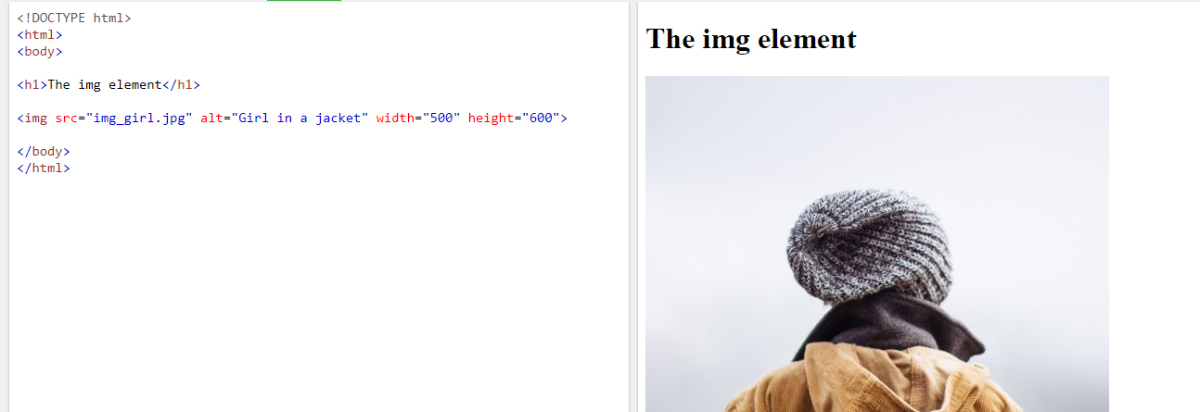
HTML <img> Tag
Example
How to insert an image:
<img src="img_girl.jpg" alt="Girl in a jacket" width="500" height="600">

Slide 39
HTML <img> Tag
Definition and Usage
The <img> tag is used to embed an image in an HTML page.
Images are not technically inserted into a web page; images are linked to web pages. The <img> tag creates a holding space for the referenced image.
The <img> tag has two required attributes: src - Specifies the path to the image alt - Specifies an alternate text for the image, if the image for some reason cannot be displayed
Note: Also, always specify the width and height of an image. If width and height are not specified, the page might flicker while the image loads.
Tip: To link an image to another document, simply nest the <img> tag inside an <a> tag (see example below).
<a href="course_outline.pdf"><img src="images/name-of-image.jpg" alt="descriptive text of image"></a>

Slide 40
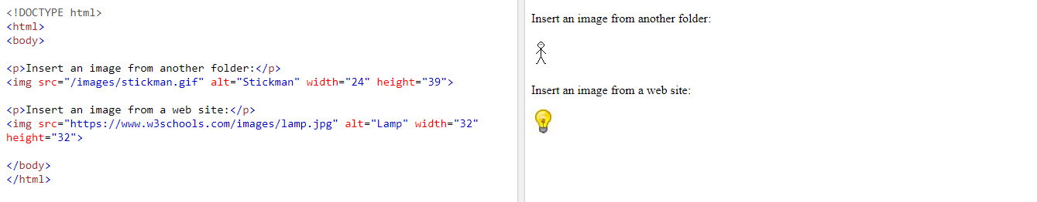
HTML <img> Tag
How to add a hyperlink to an image:
<a href="https://www.w3schools.com"> or <a href=https://www.w3schools.com target="_blank">
<img src="w3html.gif" alt="W3Schools.com" width="100" height="132">
</a>
How to insert images from another folder or from another web site:
<img src="/images/stickman.gif" alt="Stickman" width="24" height="39">
<img src="https://www.w3schools.com/images/lamp.jpg" alt="Lamp" width="32" height="32">

Slide 41
The alt Attribute
The required alt attribute provides an alternate text for an image, if the user for some reason cannot view it (because of slow connection, an error in the src attribute, or if the user uses a screen reader).
The value of the alt attribute should describe the image:
Example
<img src="img_chania.jpg" alt="Flowers in China">

